Slide 1
Pulmonary Grossing

Slide 2
Small Biopsies
Transbronchial biopsies
Flicking helps!
Best if done in the procedure room, but still helps even at the grossing bench
Helps to aerate the alveoli
Be sure to note the following:
How many fragments of tissue (do not say ‘multiple’)
Location of biopsies (include in header line)
Be sure to distinguish between endobronchial and transbronchial biopsy in the header line

Slide 3
Small Biopsies – Pre-Ordering Stains
Transbronchial biopsies for transplant
If req specifically states ‘r/o fungal infection’, order the GMS upfront
Should automatically get pentachrome
Biopsies for tumor vs. infection
Can consider ordering extra unstained slides upfront

Slide 4
Wedge Resections
Margins
Wedge specimens for ILD evaluation tend to be smaller than for tumor
Wedge specimens for tumor are more substantial, but can have very close margins
Handle the same way whenever possible…

Slide 5
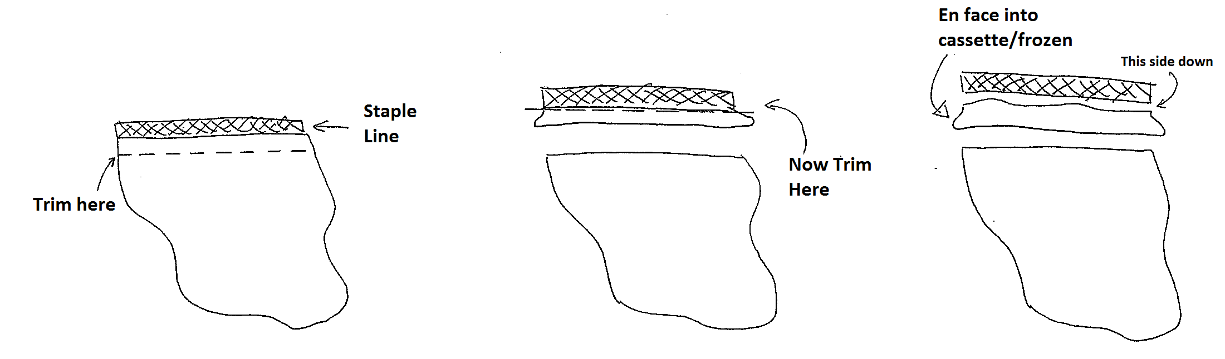
Wedge Resection Margins
Ink not necessary
Try to do this for ILD wedge biopsy/resections
Why? Sometimes tumor is identified, good to be able to comment on margins
If ILD biopsy < 1.5 cm from staple to tip, this can be challenging (OK to skip)

Slide 6
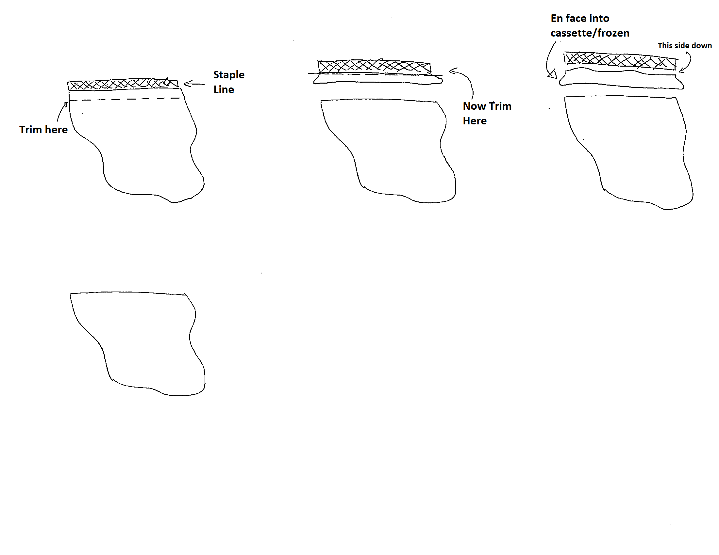
Wedge Resections/Biopsies
ILD specimens: cut on axis of longest central to peripheral axis

Slide 7
Wedge Resections/Biopsies
For Tumor:
Document tumor dimensions in 3 dimensions before cutting
Choose largest dimension
Additional 2 orthogonal dimensions
0.1 cm accuracy
Section to best document:
Largest dimension of tumor
Cut parallel with largest plane (discussed later)
Relationship to pleura (ink not necessary!)

Slide 8
Segments/Lobes/Lungs for Non-Tumor Conditions
MAC lung, Explants, COPD reduction (LVRS)
All lungs should be handled in the hood (until fixed)
Especially MAC lung should be handled in the hood!
Gross examination
Weigh and measure the (unfixed) specimen
Describe the pleura
Section and describe the parenchyma
Necrotic areas, number and size
Can be range of sizes and a categorization of number
‘Sectioning reveals 5-10 ovoid necrotic areas…’
Sampling
Can be limited, especially if necrotic areas are identified grossly
If 1 lobe (or lingula): 1 margin, 3 representative sections, additional sampling if additional areas of interest identified

Slide 9
Segments/Lobes/Lungs for Non-Tumor Conditions
Explants
The usual – weigh, measure, describe…
May be beneficial to pre-cut at 0.5-1 cm intervals and then fix for minimum 3 hours or overnight
Limited sampling required
Margins plus 2-3 sections per lobe, can put 2 sections per cassette if appropriate
Sample central and peripheral parenchyma

Slide 10
Segments/Lobes/Lungs for Non-Tumor Conditions
LVRS specimens
Minimal sampling required
Margins + 2-3 sections

Slide 11
Segments/Lobes/Lungs for Tumor
Major points to consider:
Staging information critical during grossing:
Size of tumor
Presence of additional nodules
Pleural invasion
Local lymph nodes
Margins

Slide 12
Segments/Lobes/Lungs for Tumor
Starting off:
The usual – weigh, measure, describe
Note any palpable nodules, and obtain measurements
Take margins (next slide)
Pre-cut the specimen
Section at 0.5-1 cm intervals and place in formalin with wicking
If section at 1 cm intervals, will need to go back later to cut thinner
Pre cut areas of tumor (coming up) with wicking
Tumor harvesting may have occurred (more on this later)
Allow to fix for minimum 2 hours with wicking before continuing grosssing

Slide 13
Segments/Lobes/Lungs for Tumor
Margins
Bronchovascular margin – always should be sampled
Place en face
Note whether true margin, or if staple line was removed
Parenchymal
Lobectomies:
Parenchymal staples are typically used to create clean separation lines between lobes – not true margin
Indicate in gross how far tumor is from parenchymal margin
Sample similarly to a wedge, but only in area closest to tumor
Segmentectomies
Parenchymal staples are a true margin
Sample entire margin similarly to wedge

Slide 14
Segments/Lobes/Lungs for Tumor
Tissue Procurement
Fresh tissue procurement may have already occurred
Note in the gross description that specimen was procured
Inking is not necessary – no need to try to ink after procurement

Slide 15
Segments/Lobes/Lungs for Tumor
Tumor Grossing
Nearly all of these cases will eventually have molecular analysis
Adequate (but not excessive) fixation is essential
Wicking for pre-fixation before blocking in helps
Inflation also works
Using a syringe to inject formalin into an un-cut specimen

Slide 16
Segments/Lobes/Lungs for Tumor
Major gross tumor descriptors of importance
Tumor location: Proximal vs. peripheral vs. endobronchial (what is the correlate?)
( Squamous vs. adenocarcinoma vs. carcinoid)
Demarcation: Well circumscribed vs. poorly demarcated (what is the correlate?)
(poorly demarcated – more commonly AIS/lepidic)
Consistency: Cavitation vs. solid (what is the correlate?)
(squamous cell vs. non-squamous)

Slide 17
Tumor Size
Tumor size is key factor for staging
Key cutoffs:
2.0 cm
3.0 cm
5.0 cm
7.0 cm
Any cm cutoff can be problematic from a grossing standpoint
If you document a tumor as 3.0 cm, stage is T1b
If you document a tumor as 3.1 cm, stage is T2a

Slide 18
T-Descriptors – Size of Primary Tumor
Size of Primary Tumor, pT1-3, N0 NSCLC
From: Rami-Porta R, Ball D, Crowley J et al. The IASLC lung cancer staging project: proposals for the revision of the T descriptors in the forthcoming (seventh) edition of the TNM classification for lung cancer. J Thorac Oncol 2007; 2: 593-602
Slide courtesy of IASLC

Slide 19
Tumor Grossing
Need to document histologically the largest tumor size
If does not fit into one cassette, divide into multiple cassettes
Cut parallel to longest tumor plane
Put into two cassettes
Indicate in gross that maximum tumor dimension is demonstrated in cassettes ( _)
If cut line will not be clear, indicate with ink
2.3 cm
Cut section

Slide 20
Tumor Grossing: Pleural Involvement
When you section the tumor, be aware of relationship to pleura, and maximize gross evaluation of this
Inking is not necessary
If tumor is near pleura, examine each of the sections to look for dense response between tumor and pleura
Generously sample
Demonstrating pleural invasion alters stage of small tumors from T1 to T2

Slide 21
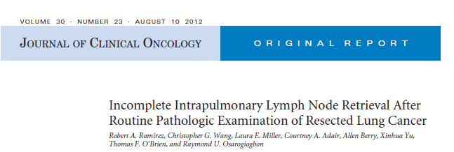
Lymph Nodes
N1 lymph nodes are often under-sampled
Why is this so important?

Slide 22
N-Descriptors - Validation
N-Stage
N0-N3, M0 NSCLC
United States National Cancer Institute SEER Registries
From: Groome PA, Bolejack V, Crowley JJ et al. The IASLC lung cancer project: validation of the proposals for revision of the T, N, and M descriptors and consequent stage groupings in the forthcoming (seventh) edition of the TNM classification of malignant tumours. J Thorac Oncol 2007; 2: 694-705
Slide courtesy of IASLC
Notes:
Survival by N-stage SEER Database. SEER-11 1998+
Groome 2007 Figure 4

Slide 23

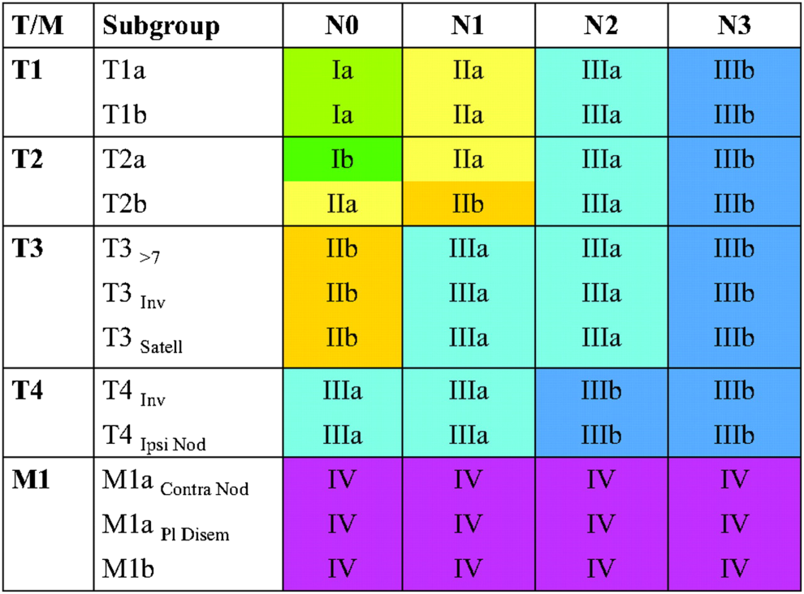
Date of download: 5/22/2013
Copyright © American College of Chest Physicians. All rights reserved.
From: The Stage Classification of Lung CancerStage Classification of Lung Cancer: Diagnosis and Management of Lung Cancer, 3rd ed: American College of Chest Physicians Evidence-Based Clinical Practice Guidelines
Chest. 2013;143(5_suppl):e191S-e210S. doi:10.1378/chest.12-2354
Figure Legend:
[Section 5.0] Stage groups according to TNM descriptor and subgroups. Reproduced with permission from Detterbeck et al.¹³

Slide 24
TNM Stage Category
Pathological Stage v. 6 and Proposed v. 7
pTNM 6th Edition
pTNM 7th Edition
From: Goldstraw P, Crowley J, Chansky K et al. The IASLC lung cancer project: proposals for the revision of the TNM stage groupings in the forthcoming (seventh) edition of the TNM classification of malignant tumours. J Thorac Oncol 2007; 2: 706-714
Slide courtesy of IASLC

Slide 25

Note the Impact of N1 nodes
pTNM 7th Edition

Slide 26
What is a N1 Lymph Node, Anyway?

Slide 27
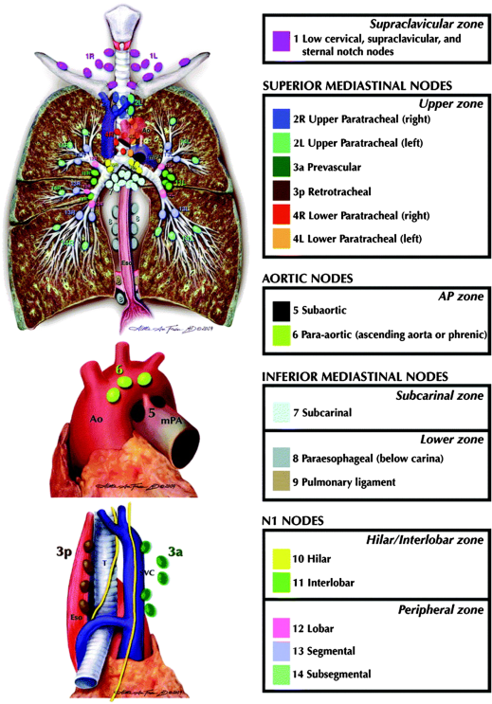
Date of download: 5/22/2013
Copyright © American College of Chest Physicians. All rights reserved.
From: The Stage Classification of Lung CancerStage Classification of Lung Cancer: Diagnosis and Management of Lung Cancer, 3rd ed: American College of Chest Physicians Evidence-Based Clinical Practice Guidelines
Chest. 2013;143(5_suppl):e191S-e210S. doi:10.1378/chest.12-2354
Figure Legend:
[Section 3.1] The International Association for the Study of Lung Cancer lymph node map, including the proposed grouping of lymph node stations into zones for the purposes of prognostic analyses. Ao = aorta; Eso = esophagus; L = left side; mPA = main pulmonary artery; R = right side; SVC = superior vena cava; T = trachea. Reproduced with permission from Rusch et al.²⁴

Slide 28

What is a N1 Lymph Node, Anyway?
Any double-digit lymph node is N1
Nodes that come out with lobectomy specimens are almost always, by definition, N1
Usually under-sampled at the grossing bench

Slide 29
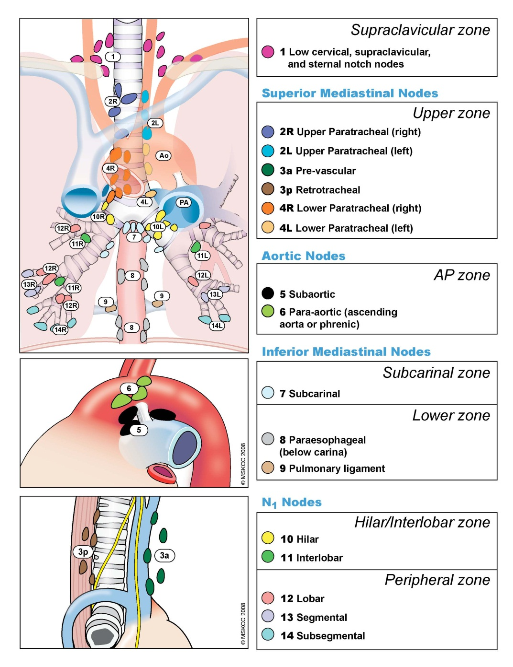
Slide courtesy of IASLC

Slide 30
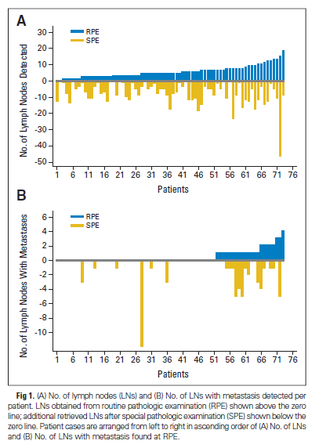

Slide 31

Retrieving Lymph Nodes
Usually easier on fixed specimens
After bronchovascular margin is removed, use scissors to cut down at least two different planes of the bronchial tree
Blunt dissect as necessary adjacent to the bronchovascular tree
Cut at fine intervals to identify additional potential lymph nodes

Slide 32
Radiologic-Pathologic Correlation
Look up available radiology on ALL cases
This is essential for:
Comparison of radiologically identified tumor size
Determination of whether additional nodules were identified radiologically

